Slide 1
Data sharing and reuse
lennart martens @compomics
lennart.martens@ugent.be
computational omics and systems biology group
Ghent University and VIB, Ghent, Belgium

Slide 2
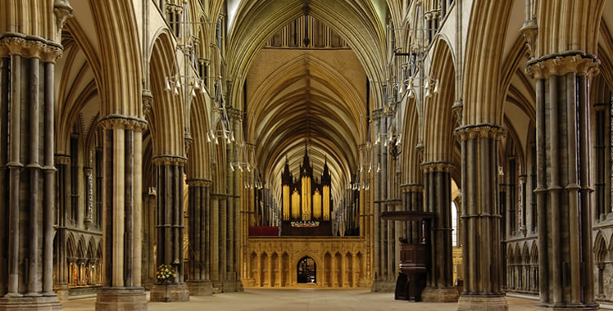
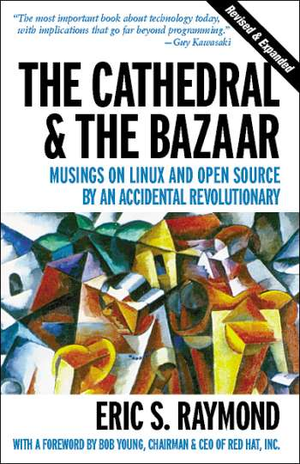
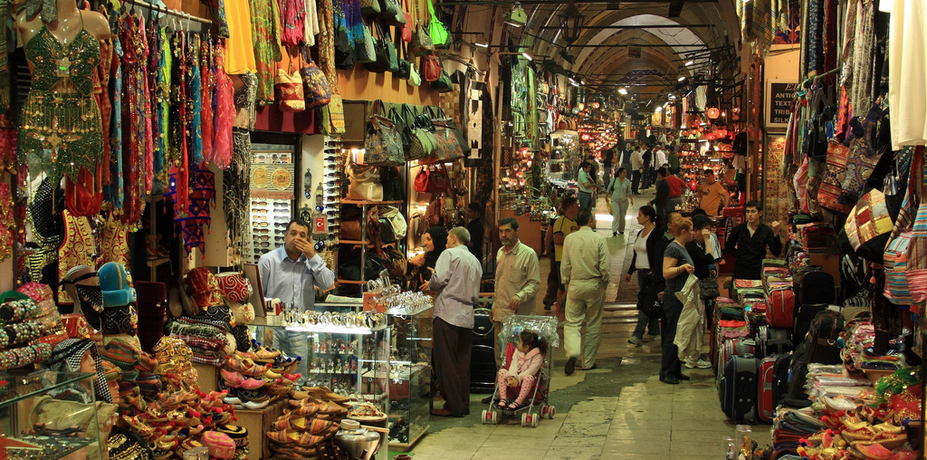
Lincoln Cathedral, Lincolnshire UK
Grand Bazaar, Istanbul, Turkey

Slide 3
Why should we be re-using data?
Four types of (proteomics) data re-use
Unbiased proteome-wide (PT)M discovery as example
A subject of sociological study

Slide 4
Why should we be re-using data?
Four types of (proteomics) data re-use
Unbiased proteome-wide (PT)M discovery as example
A subject of sociological study

Slide 5
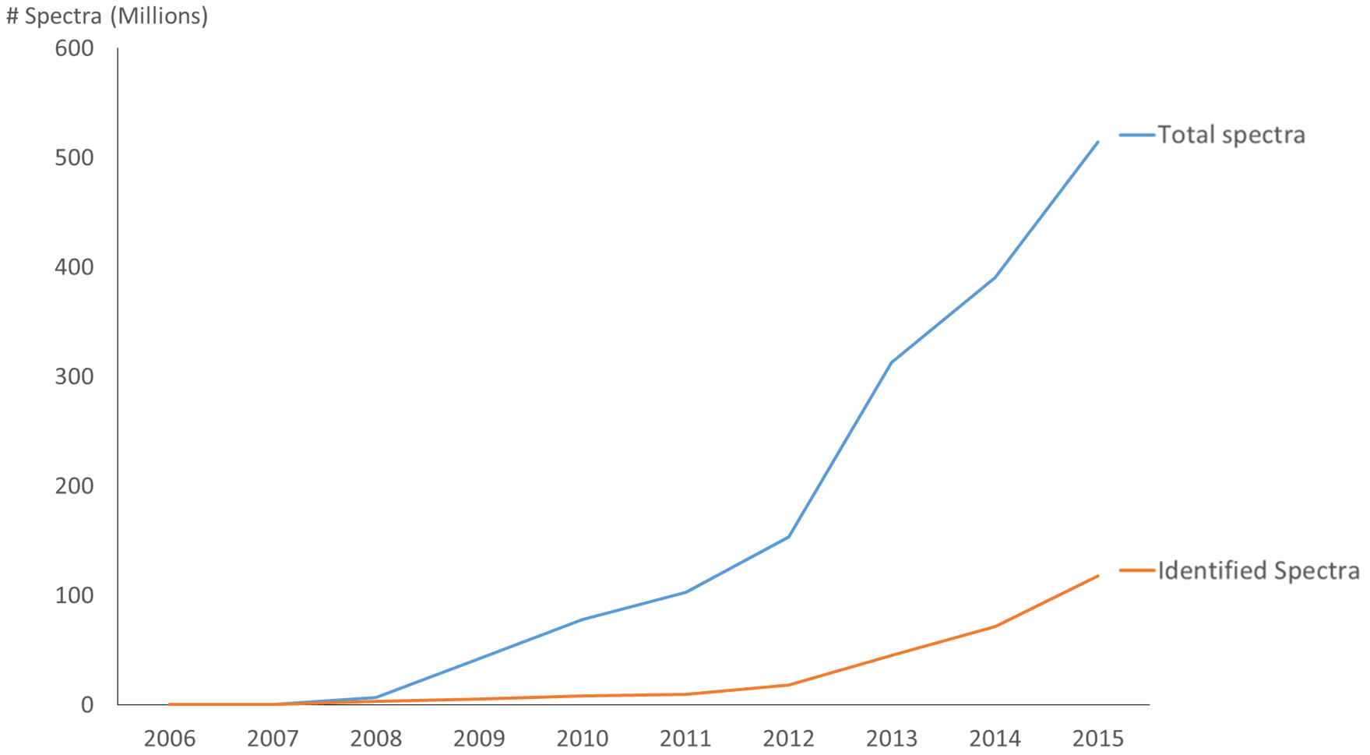
Mass spectrometry data is high-content, meaning that much more data is acquired than is used in most papers

Slide 6
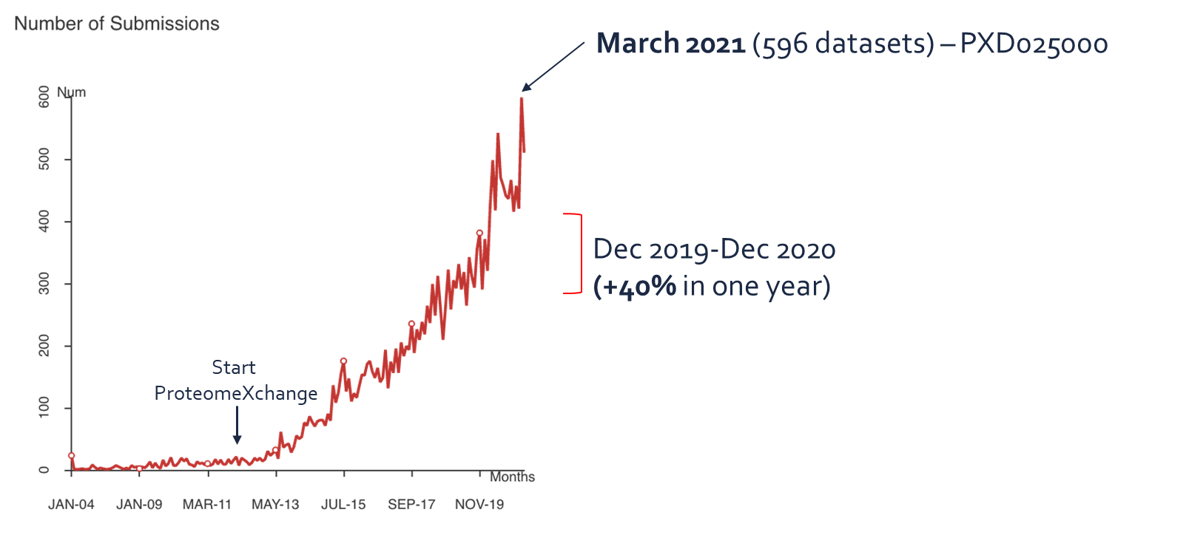
Mass spectrometry is also high throughput, meaning there is lots of data available!
An average of ~450 datasets/month during 2020
~5,300 datasets in 2020
Slide courtesy of Dr. Juan Antonio Vizcaíno, Proteomics Team Leader, EMBL-EBI

Slide 7
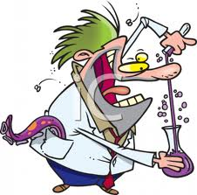
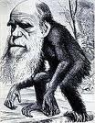
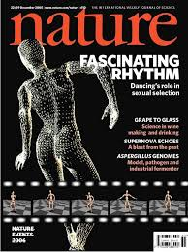
As the volume and content of data increases in a field, the role of bioinformatics in that field changes as well
Bazaar
Repository

Slide 8
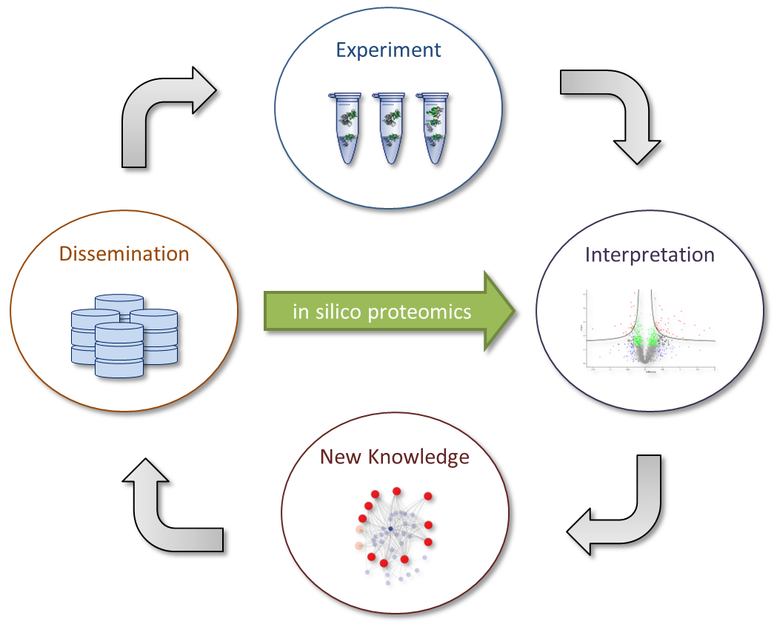
The data life cycle shows how in silico re-use of data fits in with the overall flow of information
in silico analysis
Vaudel, Proteomics, 2016

Slide 9
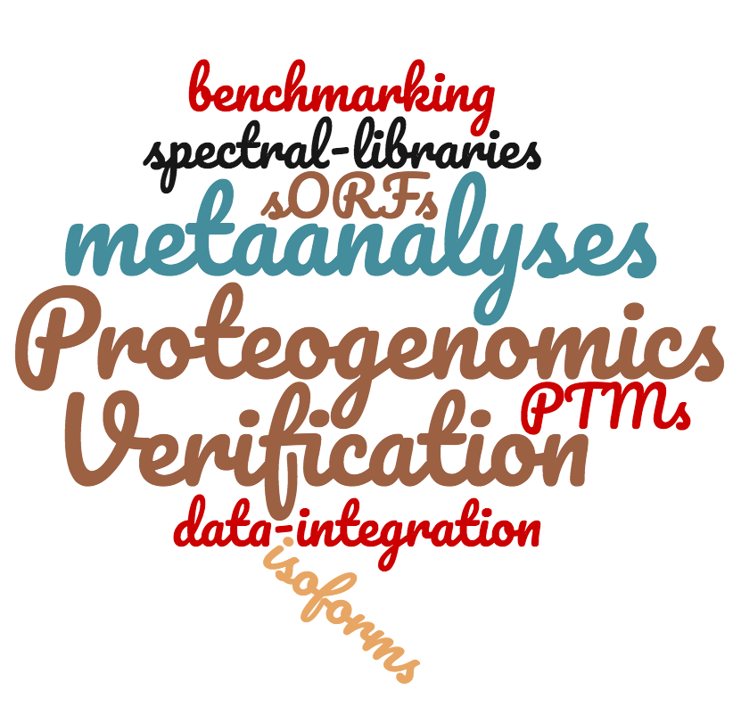
And this is seen in practice in proteomics as data is increasingly re-used
Year
Slide courtesy of Dr. Juan Antonio Vizcaíno, Proteomics Team Leader, EMBL-EBI

Slide 10
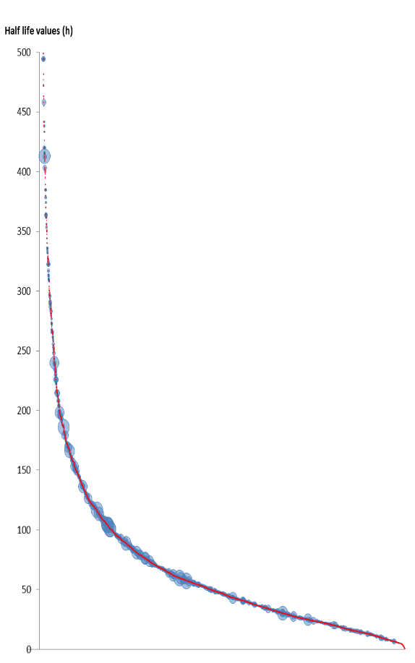
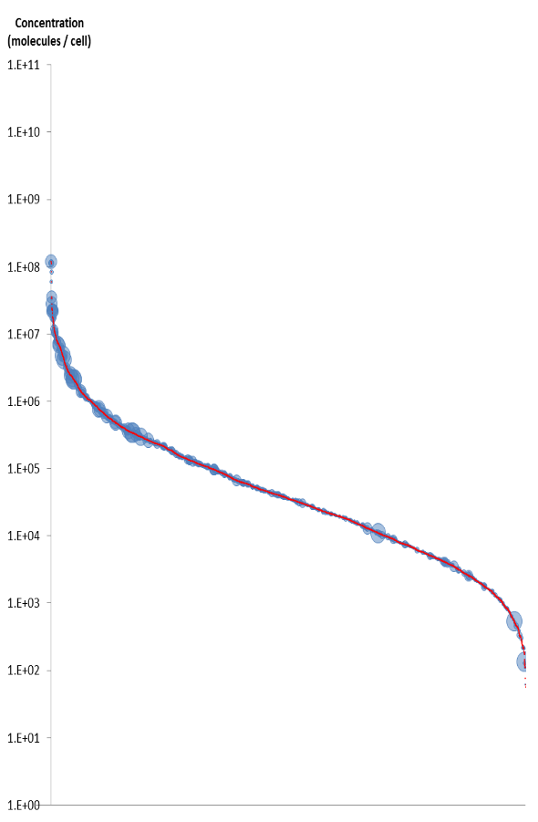
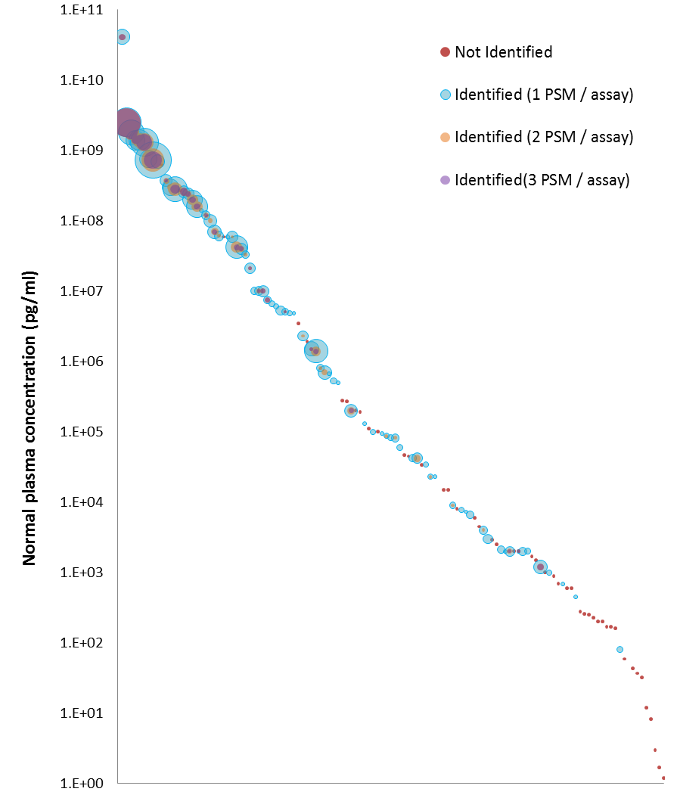
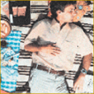
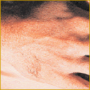
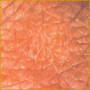
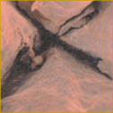
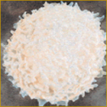
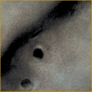
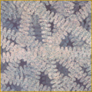
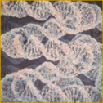
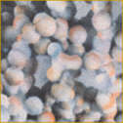
Large-scale data reprocessing can harness heterogeneity to dig very deep into the proteome
Half life (h)
concentration
(copies per cell)
concentration
(pg/ml)
proteins
proteins
Verheggen, Journal of Proteome Research, 2017

Slide 11
Why should we be re-using data?
Four types of (proteomics) data re-use
Unbiased proteome-wide (PT)M discovery as example
A subject of sociological study

Slide 12
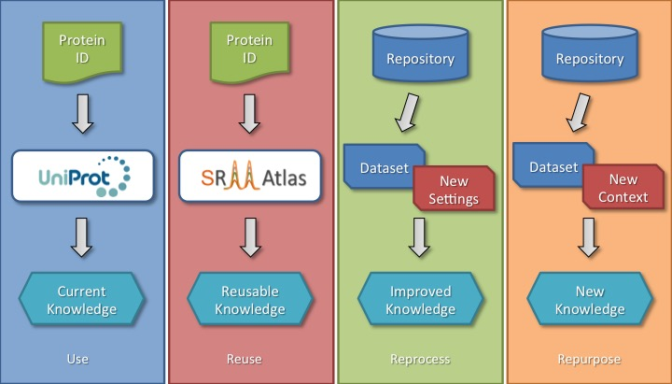
In general, data re-use can take four distinct forms, all of which are somehow applied in our example
Vaudel, Proteomics, 2016

Slide 13
Why should we be re-using data?
Four types of (proteomics) data re-use
Unbiased proteome-wide (PT)M discovery as example
A subject of sociological study

Slide 14
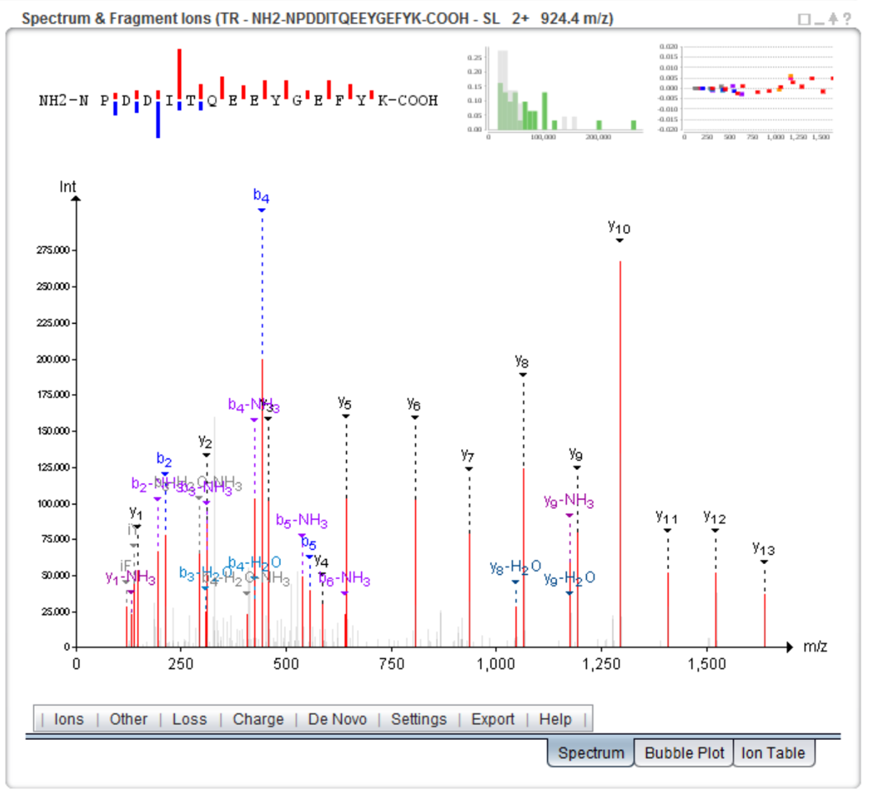
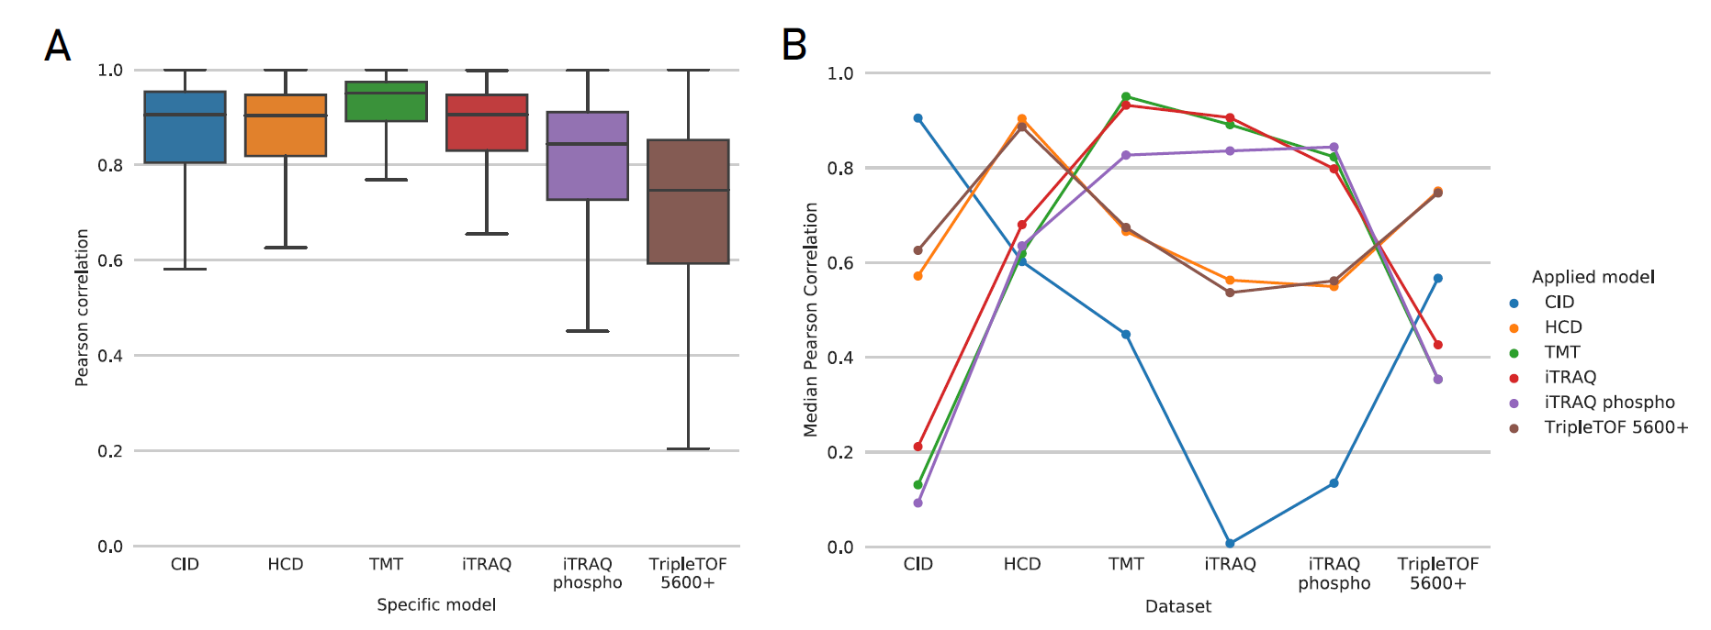
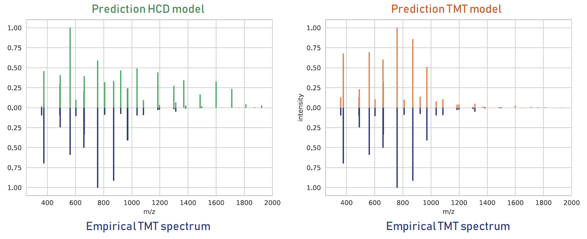
Our MS2PIP fragmentation model accurately predicts peptide behaviour in varying conditions
https://iomics.ugent.be/ms2pip
Degroeve, Bioinformatics, 2013
Degroeve, Nucleic Acids Research, 2015
Vaudel, Nat. Biotech., 2015
PeptideShaker
Gabriels, Nucleic Acids Research, 2019

Slide 15
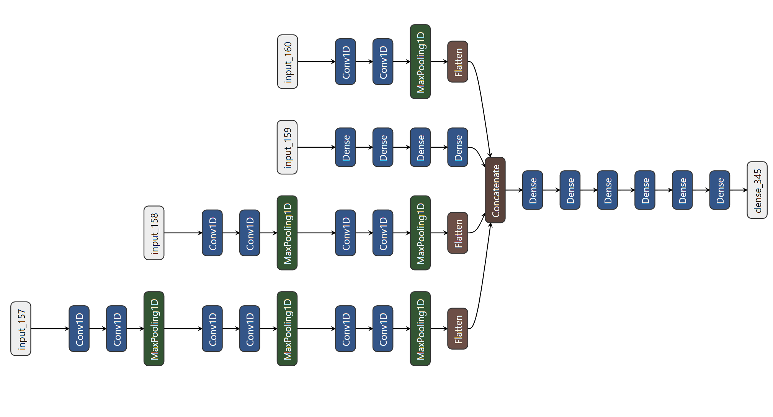
DeepLC is a retention time predictor that can accurately predict retention times of as-yet unseen modifications
AAAAGSLDK
A A A A G S L D K
Isomeric features
Feature | Value
Length | 9
Mass | 802.42
Compositional counts | C = 36, H = 72, …
Global features
Combining representations
Two amino acids
AA AA GS LD K
A A A A G S L D K
Dense layer
Single amino acids
Convolutional layer
Maxpooling layer
Input/output layer
Dimensional consistency layer
Bouwmeester, Nature Methods, accepted - https://www.biorxiv.org/content/10.1101/2020.03.28.013003v2

Slide 16
The performance of DeepLC is on par with the state-of-the-art
Predicted retention time (min)
DeepRT+ (Ma, Anal. Chem, 2018)
R: 0.997
${∆t}_{95\%}$: 13.7 min
Guan et al. MCP, 2019)
R: 0.994
${∆t}_{95\%}$: 10.825 min
Observed retention time (min)
Dataset from Zolg, MCP, 2018
Bouwmeester, Nature Methods, accepted - https://www.biorxiv.org/content/10.1101/2020.03.28.013003v2

Slide 17
DeepLC can accurately predict t_{R} for many modifications, despite never having seen these before
acetylation
succinylation
propionylation
DeepLC prediction
Traditional prediction
phosphorylation
crotonylation
malonylation
Dataset from Zolg, MCP, 2018
Bouwmeester, Nature Methods, accepted - https://www.biorxiv.org/content/10.1101/2020.03.28.013003v2
Notes:
But now for something we can do but DeepRT cannot
On the left we predict the retention time for peptides that have a dioxidation modification
However we ignore this modification
On the right we do take the modification into account
As you can see the shift is fairly well predicted

Slide 18
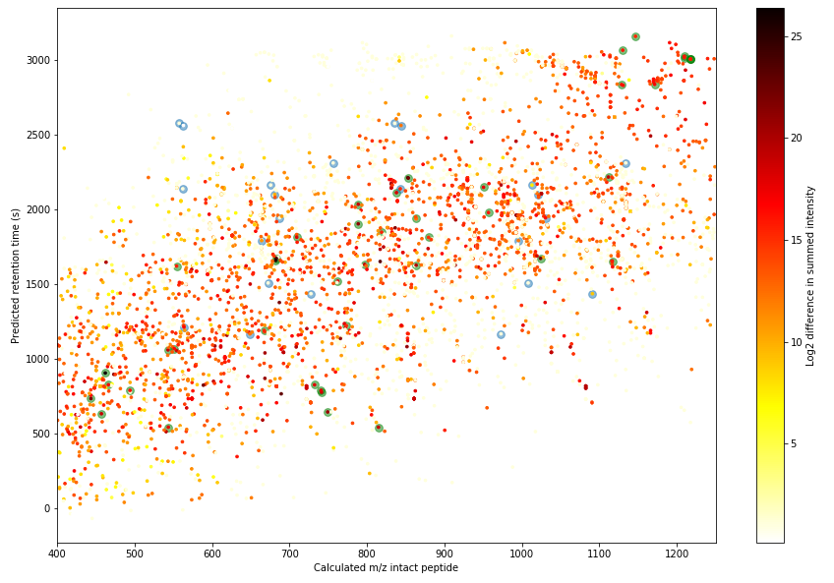
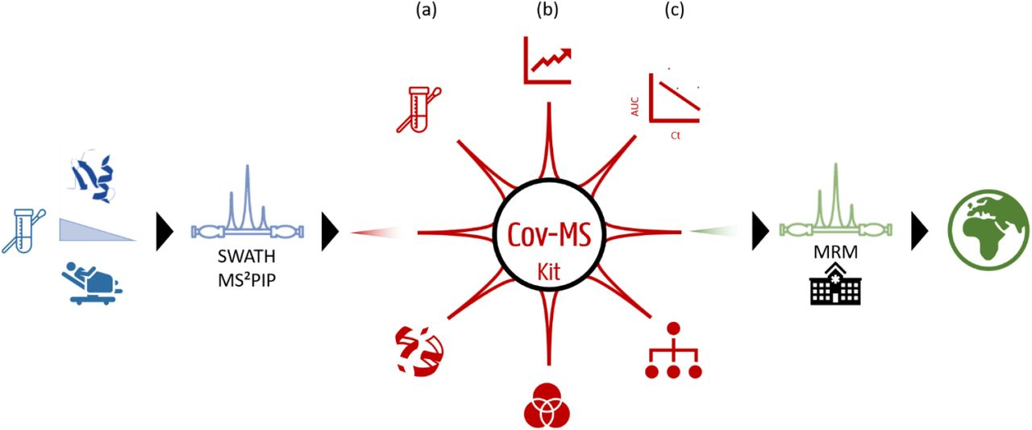
MS2PIP and DeepLC were crucial in the development of a targeted MS-based COVID-19 test that runs in 38 mins
Maarten Dhaenens
UGent
Van Puyvelde, JACS Au, 2021

Slide 19
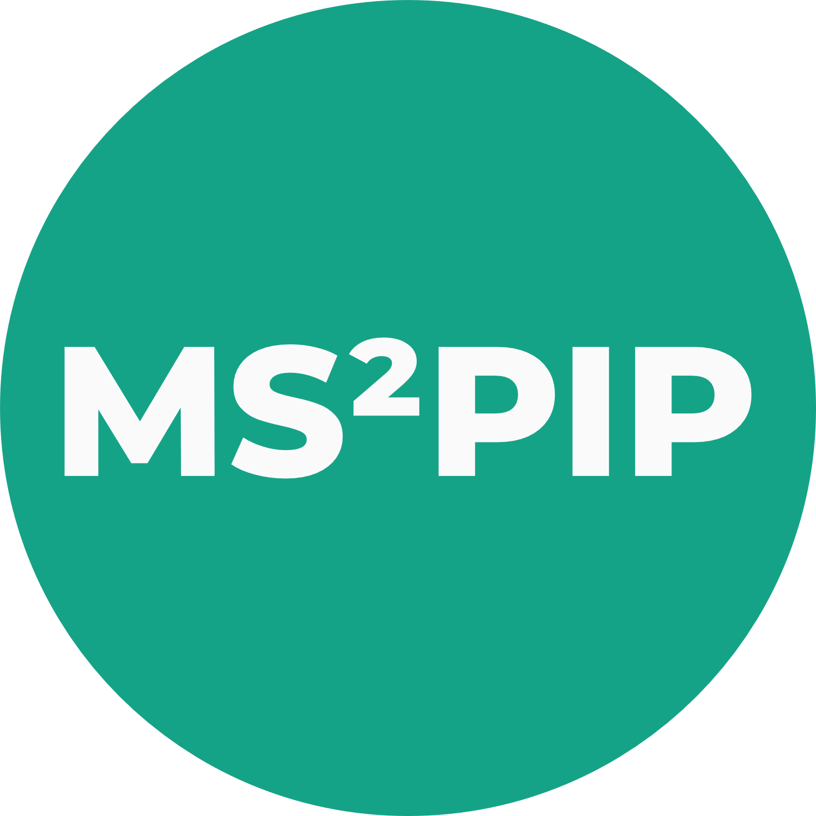
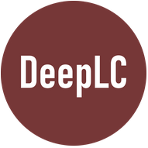
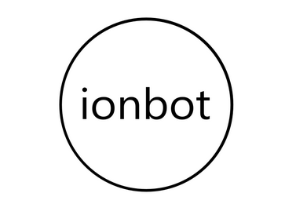
MS2PIP and DeepLC power ionbot, a novel and extensible open modification search engine with high reliability
improved ML-based algorithms
…
ML models
predictions
fully machine learning-based scoring
sensitive and highly accurate
identification of (modified) peptides
Degroeve, https://www.biorxiv.org/content/10.1101/2021.07.02.450686v1

Slide 20
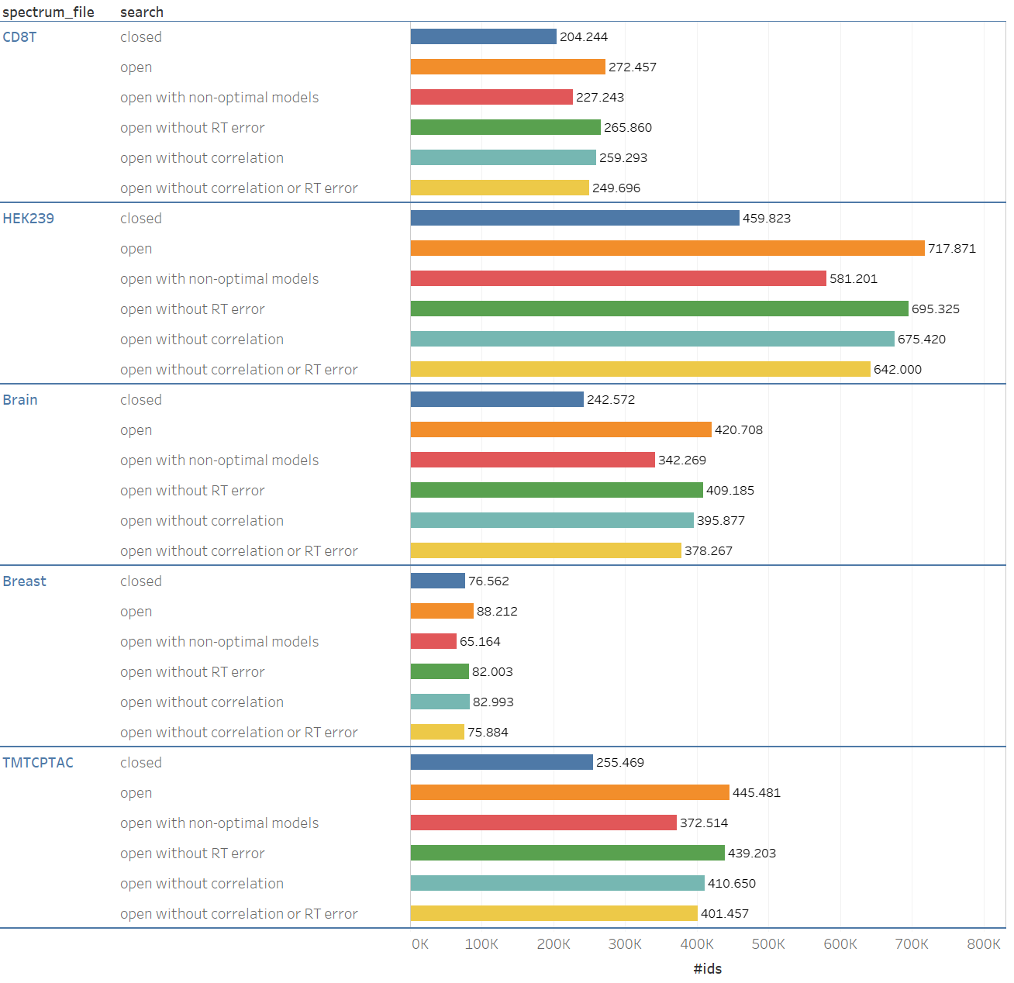
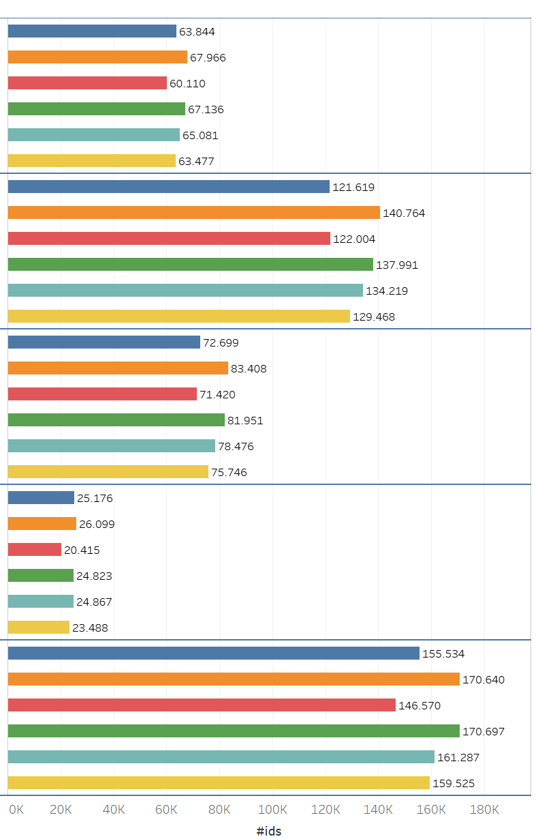
Ionbot shows the value of open modification searches, as well as the value of accurate prediction models
PSMs
peptides
Degroeve, https://www.biorxiv.org/content/10.1101/2021.07.02.450686v1

Slide 21
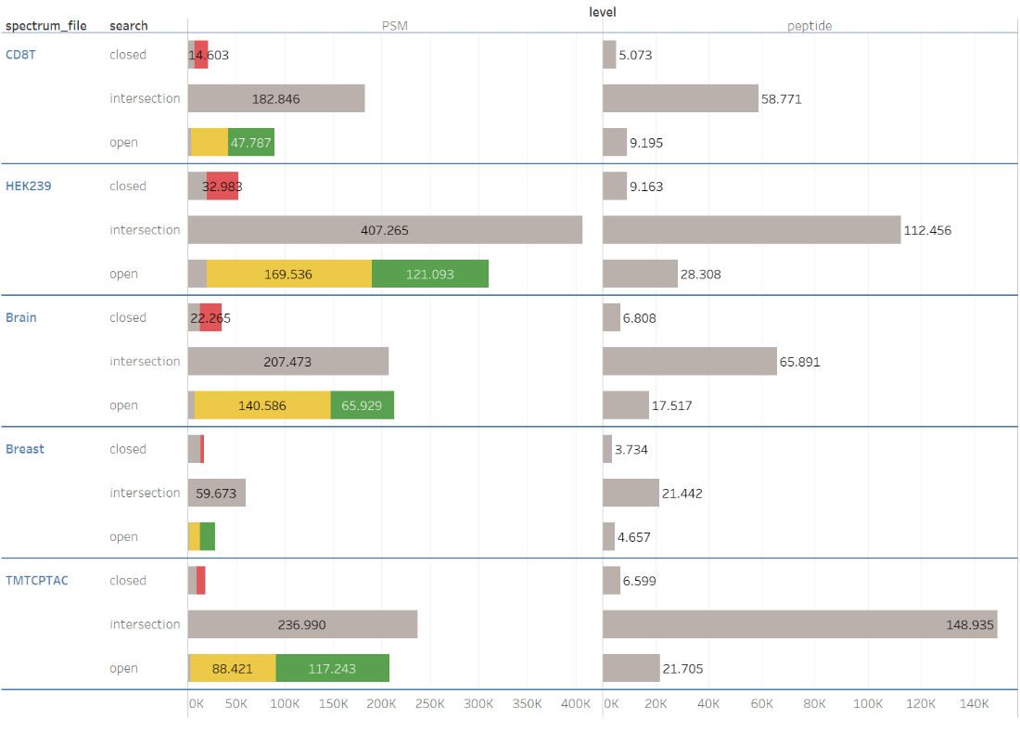
Interestingly, many identifications from the closed search are overruled by ionbot in the open search
overruled by ionbot
unexpected modification
large mass window
Degroeve, https://www.biorxiv.org/content/10.1101/2021.07.02.450686v1

Slide 22
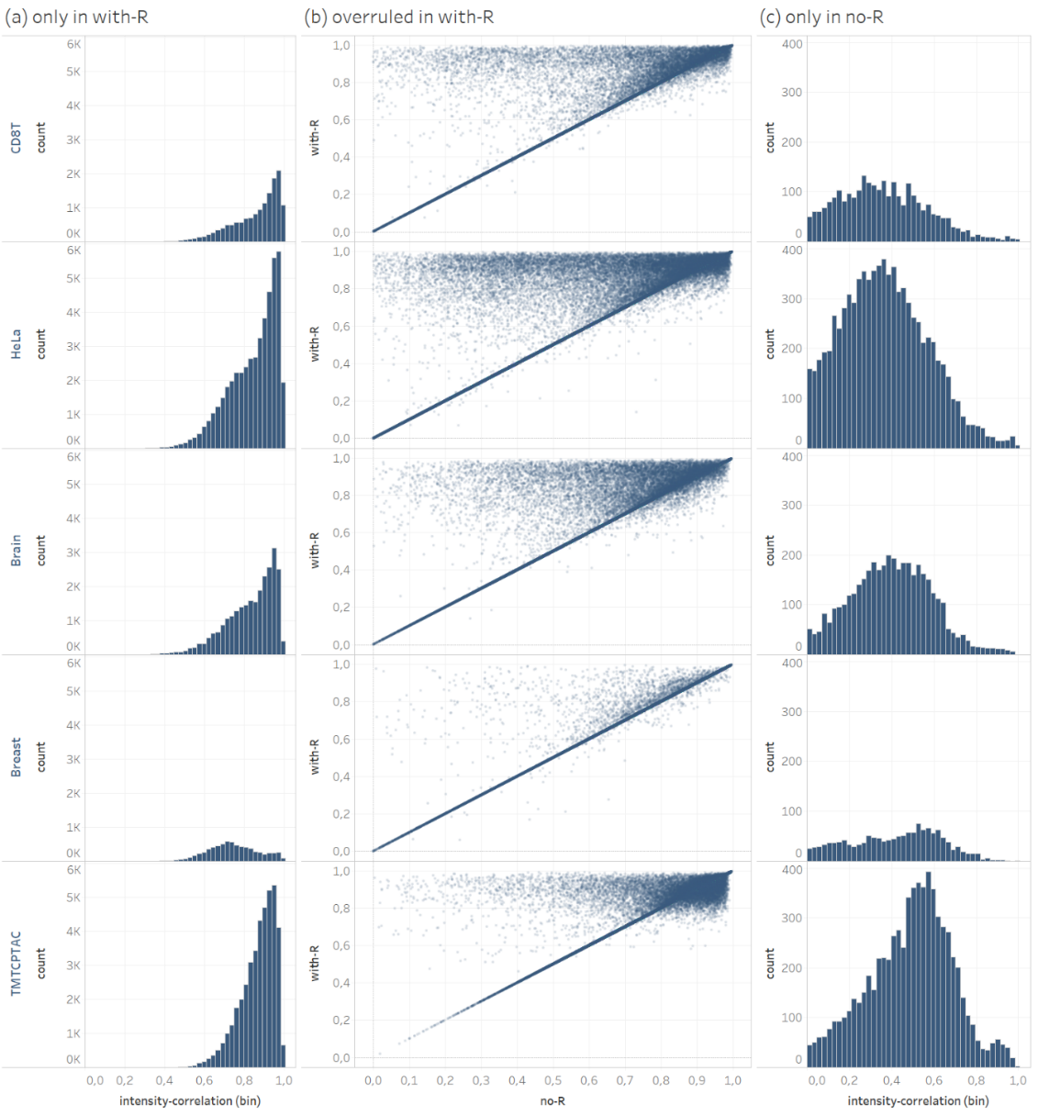
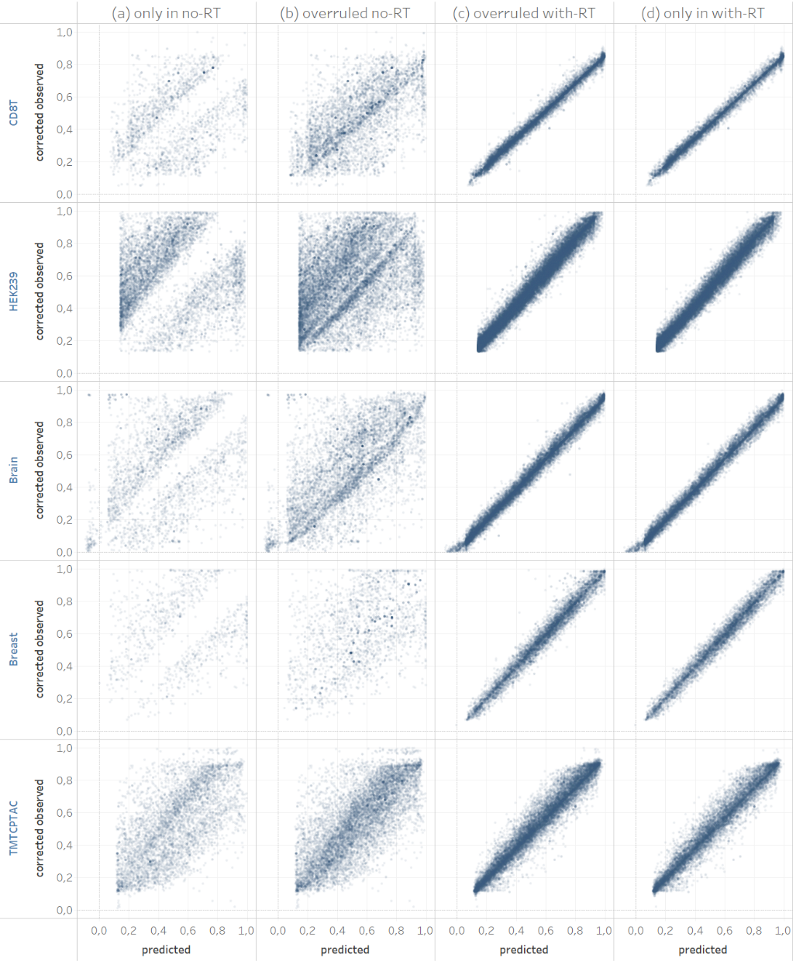
Overruled identifications are better, as shown for results obtained with, and without predictions provided to ionbot
Intensity correlation
t_{R} correlation
Degroeve, https://www.biorxiv.org/content/10.1101/2021.07.02.450686v1

Slide 23
We reprocessed a large amount of phosphoproteomics data using ionbot, and made it available through Scop3P
scop3P
www.ebi.ac.uk/pride
1490 UniMod modifications
all possible AA mutations
iomics.ugent.be/scop3p
2016 RAW files
60.2 million spectra
19.2 million PSMs
139 048 P-sites
94 111 sites, PhosphoRS > 0.5
14 261 phosphoproteins
https://iomics.ugent.be/scop3p
Ramasamy, Journal of Proteome Research, 2020

Slide 24
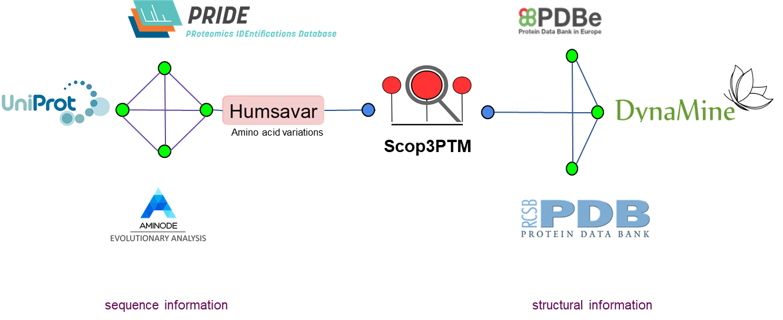
Scop3PTM integrates protein information at the residue level from a variety of resources

Slide 25
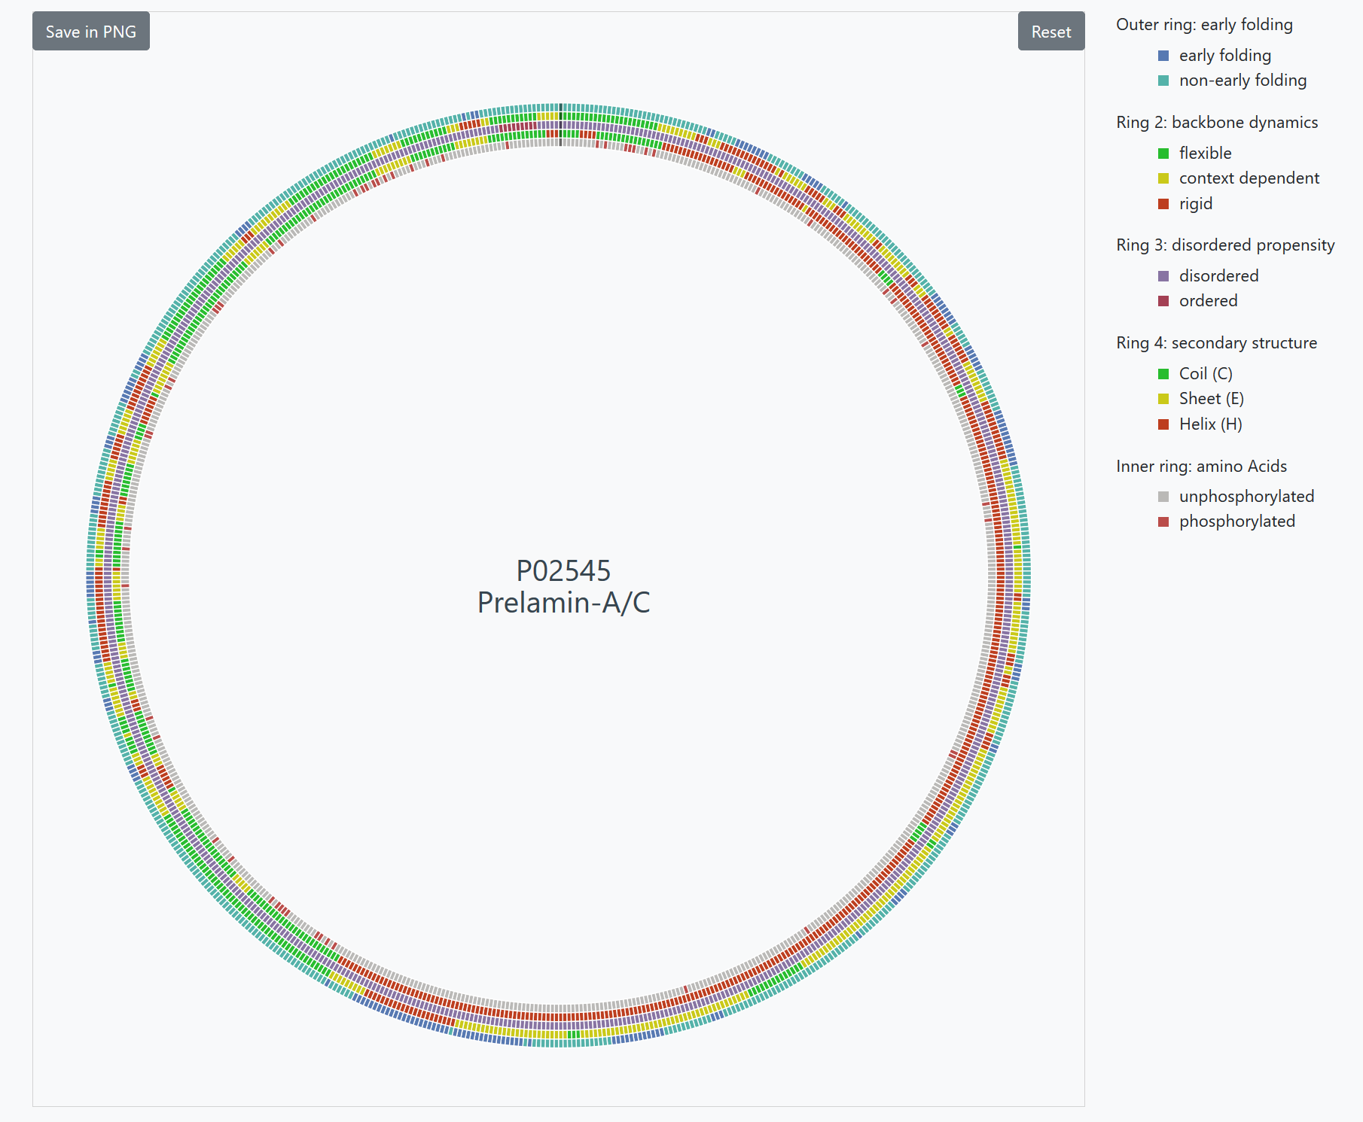
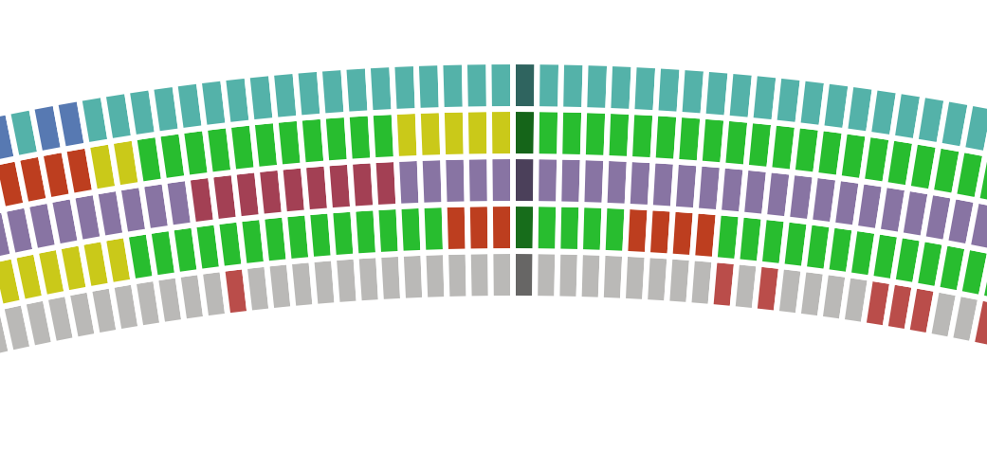
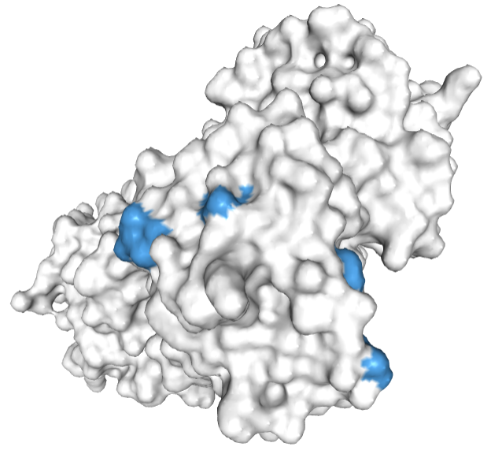
Scop3P shows these results interactively on the web, and presents REST APIs for 3rd party re-use
https://iomics.ugent.be/scop3p
Ramasamy, Journal of Proteome Research, 2020

Slide 26
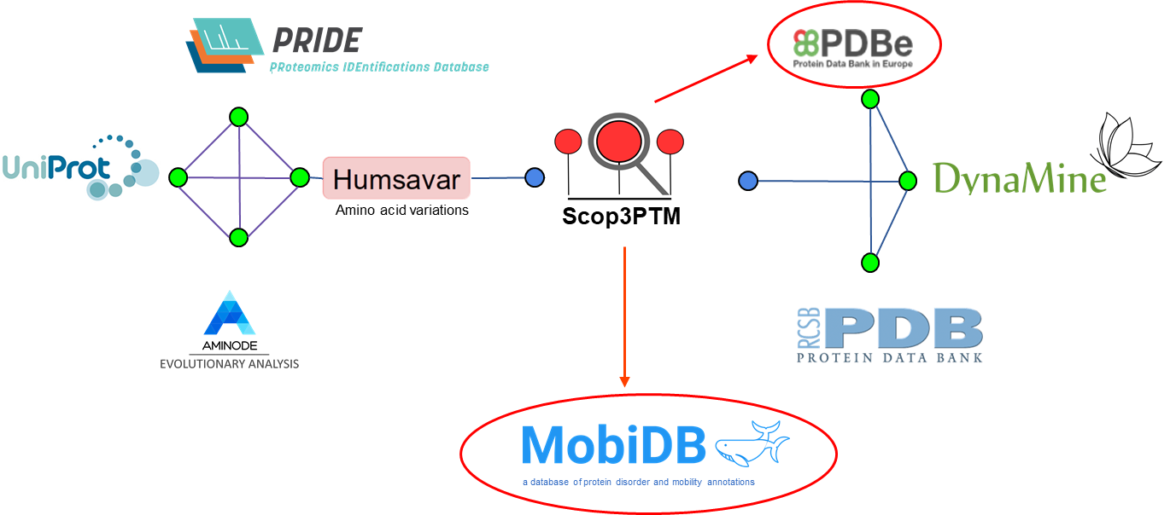
Closing the circle, Scop3P itself becomes a resource for use and re-use by others!

Slide 27
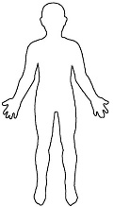
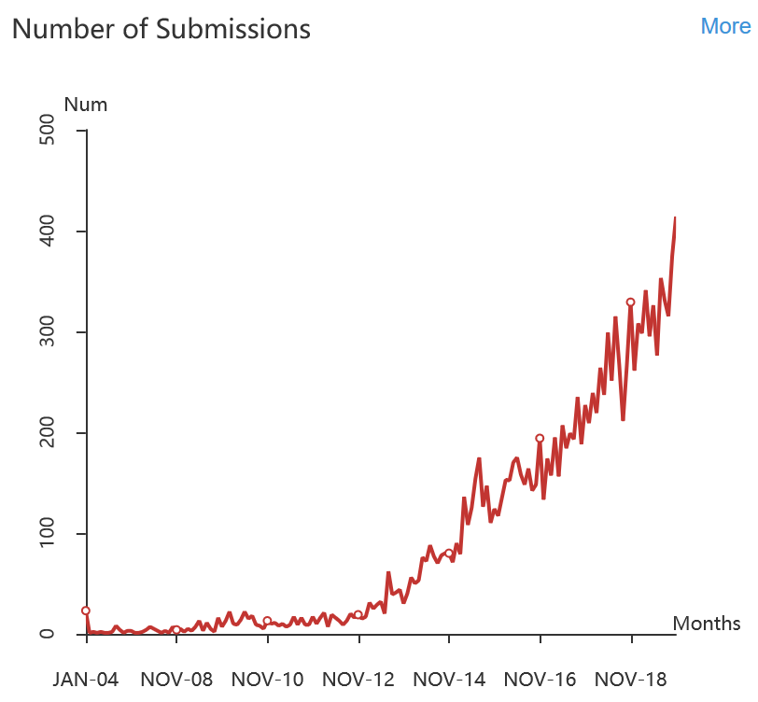
And we are now running ionbot on all human spectra contained in the PRIDE database
215,046,444 PSMs
742,422 unique peptides
20,246 proteins
444 modifications
4,869,660 modified residues
1490 UniMod modifications
all possible AA mutations
25 314 RAW files
1 billion spectra

Slide 28
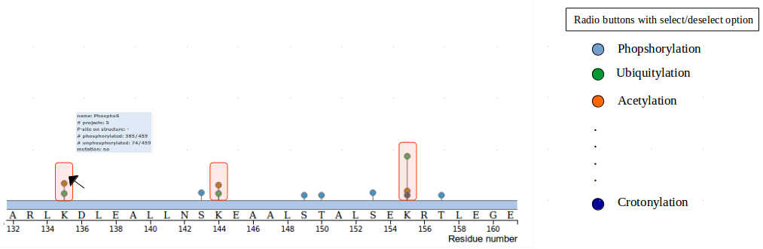
Scop3PTM will become a proteome-wide PTM detection knowledgebase
PTM

Slide 29
Why should we be re-using data?
Four types of (proteomics) data re-use
Unbiased proteome-wide (PT)M discovery as example
A subject of sociological study

Slide 30
A sociological take on work of my group highlights the key benefits of open science
“This desire to reactivate data is widespread, and Klie et al. are not alone in wanting to show that ‘far from being places where data goes to die’ (Klie et al., 2007: 190), such data collections can be mined for valuable information that could not be obtained in any other way.”
“In attempting to reactivate sedimented data in order to enable its re-use, their first step was ...”
"... they are experiments in seeing, in furnishing ways of seeing how data on proteins could become re-usable, could be reactivated as collective property rather than the by-product of publication."
Mackenzie and McNally, Theory, Culture and Society, 2013

Slide 31
Gift shop at Chester Cathedral, UK

Slide 32
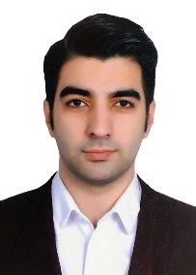
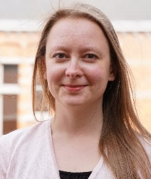
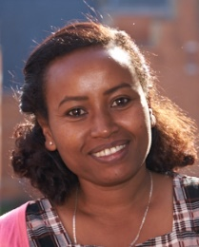
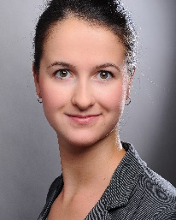
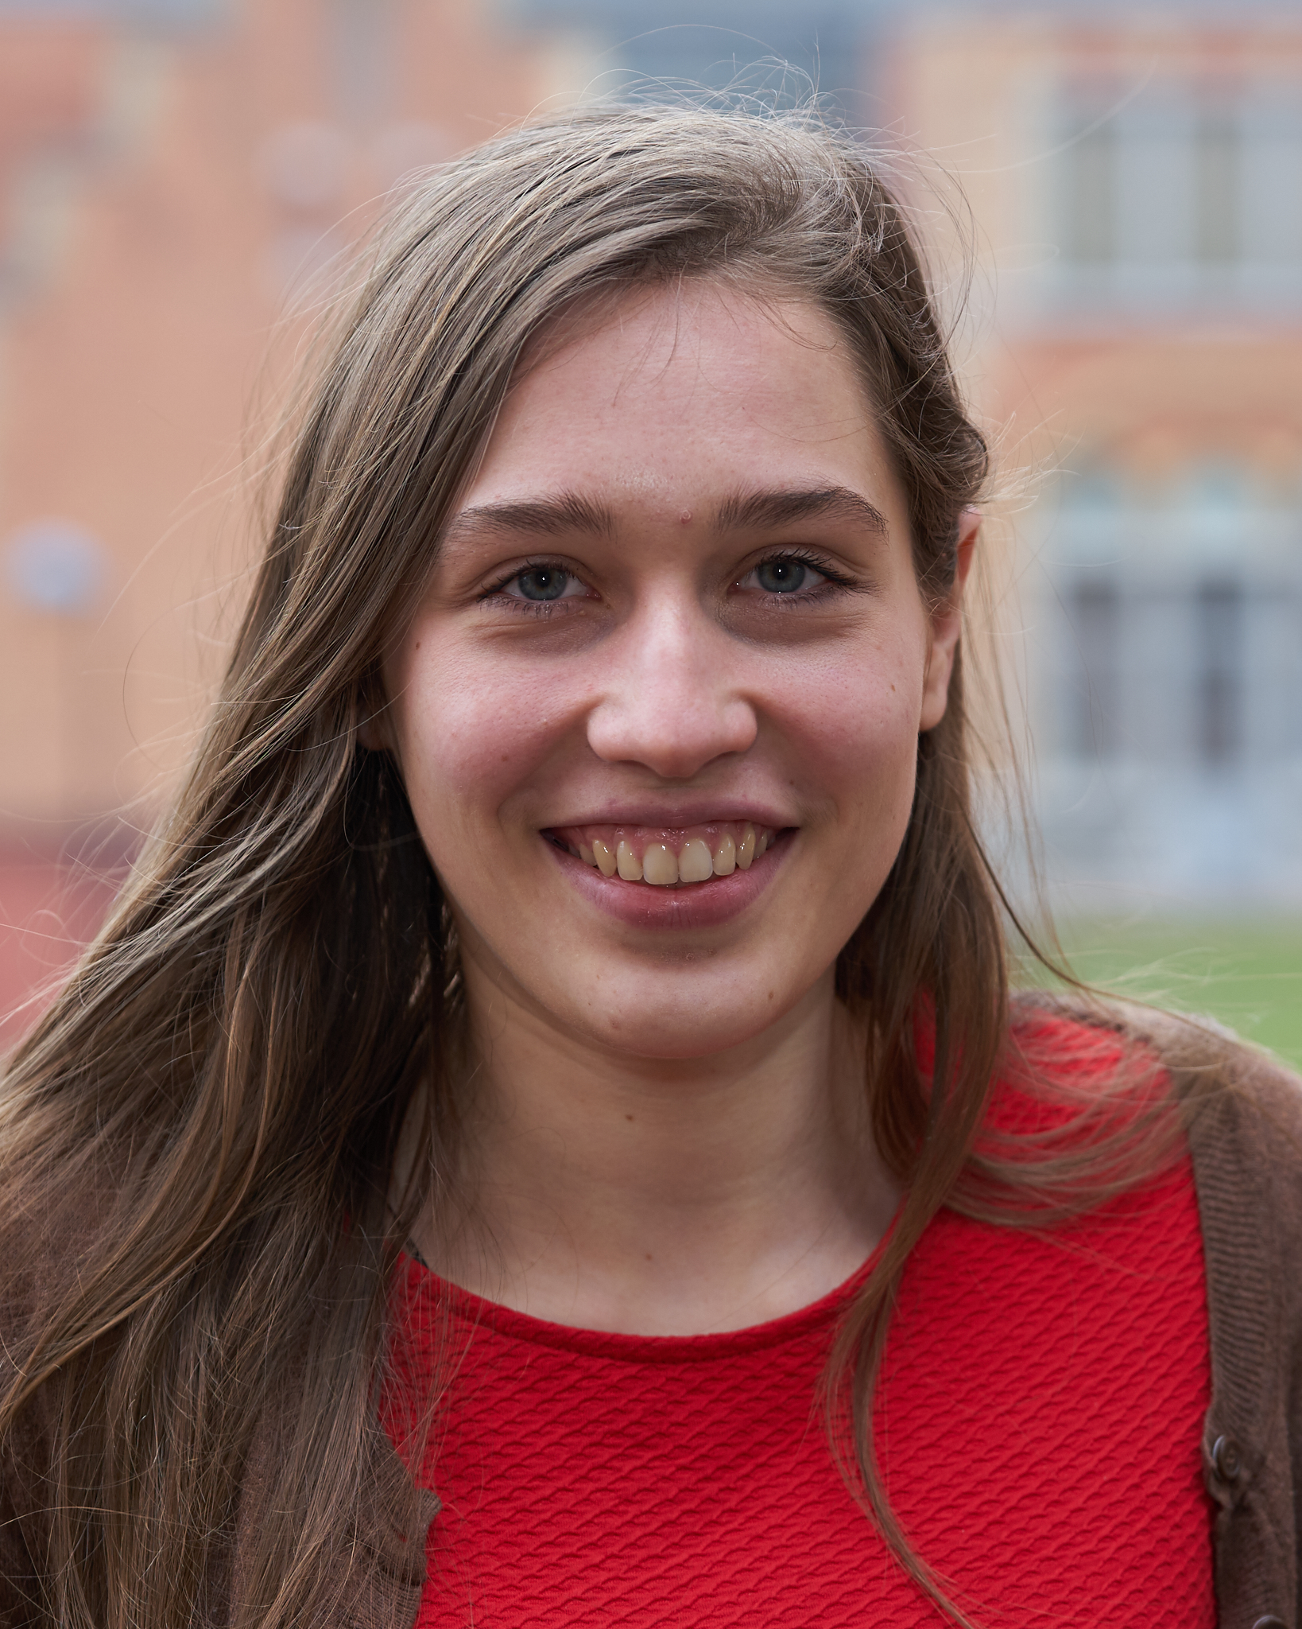
www.compomics.com
@compomics

